Slide 1
Get on the Path to Growth
October 2020

Slide 2
Agenda
Act! Overview
1
Why Choose
2
Benefits to Your Business
3
Plans & Pricing
4
What’s New
5

Slide 3
What is Act!?

Slide 4
Act! combines proven CRM with
powerful Marketing Automation, providing everything you need to market like a pro, turn leads into sales,
and win raving fans for life.

Slide 5
Why choose Act!?

Slide 6
Sales & marketing
in one.
Achieve sales and marketing greatness with the all in one solution designed just for small and midsized businesses.
Fit for your
journey.
Grow as you go with affordable options perfect for your unique business—no matter where you are on your journey.
A recognized
leader.
Rest easy when you partner with a recognized leader with millions of happy customers all around the world.

Slide 7
How does Act! benefit my business?

Slide 8
CRM and Marketing Automation together as one.
Watch as your business goals become a reality with
proven CRM and powerful Marketing Automation in one.
Just look at what’s possible with Act!.
Delight every customer, every time.
Market like
a pro.
Turn leads into sales.
Win raving fans for life.
Focus where it counts.
Get organized—and get busy.

Slide 9
Delight every customer, every time.
Where no detail is forgotten and meaningful interactions happen.
Imagine this—a top customer calls unexpectedly, but you don’t sweat it. In an instant you’re informed and prepared with a comprehensive view of all their interactions with your company, no matter where you are. With all this rich information, you personalize conversations and build trust, because you know things like which products they have, when their contracts are expiring, the last time you spoke, even down to their birthday and kids’ names. You nailed it! All your customers think they’re your best and most valued.

Slide 10
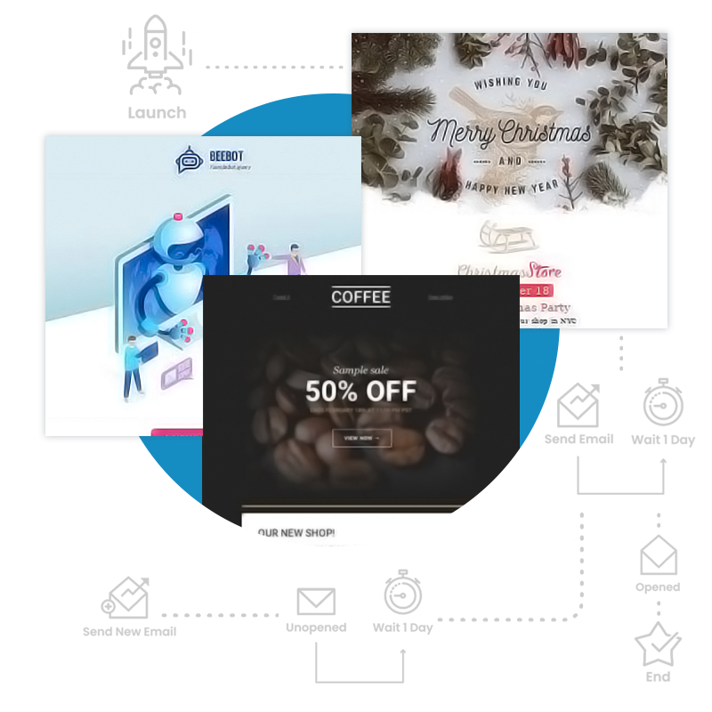
Market like a pro.
Powerful tools to attract business and promote your brand.
Need to get the word out about your business, but don’t know where to start? It’s easier than you think! Send impactful emails that promote your products or services and look professional, without a big budget or marketing expertise. You take it a step further to really set yourself apart from the competition and build the perfect journey for your customers with automated outreach in each step. Your results only get better over time, because real-time metrics tell you what’s working and what’s not. Plus, you have the tools to capture new leads, profile your prospects progressively, and turn website visitors into paying customers—just like a marketing pro!

Slide 11
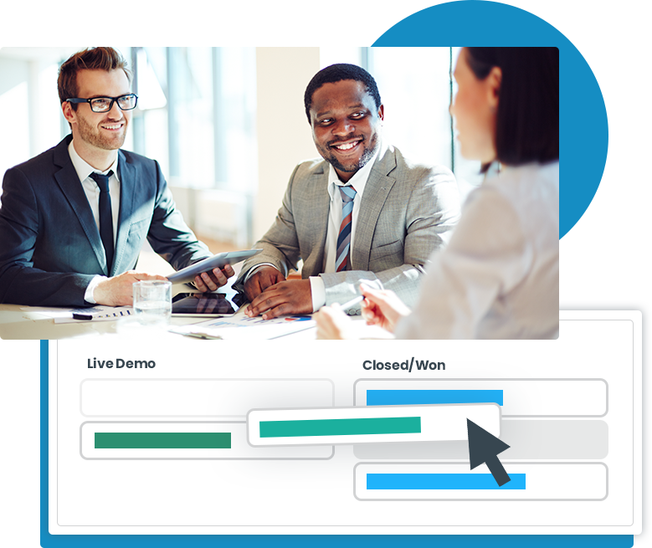
Turn leads into sales.
A straight line to sales success.
Stop guessing which deals will close each month. Focus on your most valuable opportunities to hit your sales goals every month! Hot leads end up in your hands while they’re ready to buy, because your marketing and sales efforts are fully connected. Because you track and manage every detail of your open opportunities, you forecast accurately, uncover potential issues and opportunities, and quickly adjust your strategy with ease. You even identify trends from any deals you’ve lost. Don’t worry, everyone on your team advances deals through a standardized sales process you define.

Slide 12
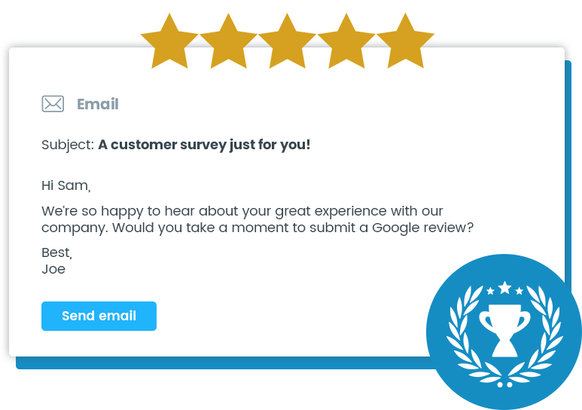
Win raving fans for life.
From leads to sales to 5-star reviews.
It’s more expensive to acquire a new customer than it is to keep one. But too many companies focus only on the top of the funnel. Stay engaged with your customers and continuously delight them after their initial purchase. With an assist from automated communications and activities you define, you deliver the right message at the right time. This makes it easy to upsell products or services to your existing customers, renew their contracts before they expire, and check in regularly to ensure they’re happy and advocating your brand. Glowing reviews and enthusiastic referrals are yours for the taking!

Slide 13
Focus where it counts.
Finally, a cheat sheet for your unique business.
Wouldn’t it be nice to know exactly where to focus your limited time and valuable resources? Good news, it’s possible! Know exactly how your business and employees are performing with dynamic, visual snapshots of real-time metrics. Sales, marketing, and business health KPIs mean smarter decision-making is an easy reality. Work in real estate, finance, manufacturing, or other specialized industries? No problem. Really drill-down and fine-tune your strategies with insights specific to your unique industry.

Slide 14
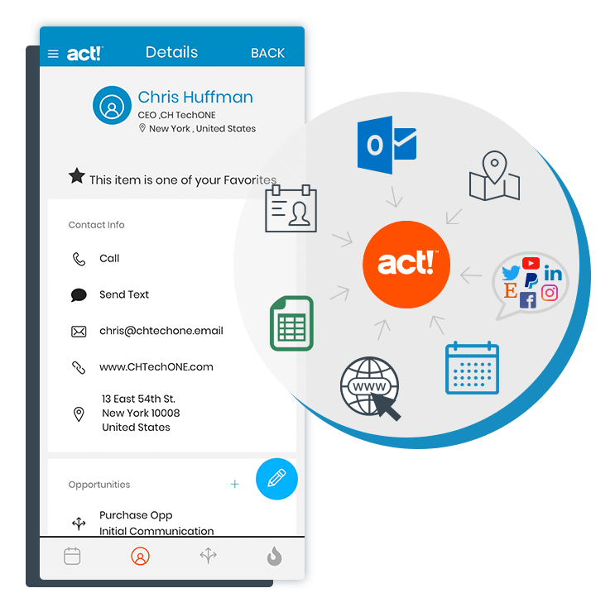
Get organized—and get busy.
A place for everything and everything in its place.
You used to track emails in one system, sales deals in another…the list goes on. Now you have a place for everything related to your business. Your customer details, emails, notes about your accounts, attachments, campaign results, and even industry-specific data are all organized and easily searchable. Need the details from the office, on the road, or even when you’re disconnected? You’re covered. Want to work seamlessly with business apps like Outlook®, Slack™, and QuickBooks® Online? You guessed it, you’re covered there too.

Slide 15
What are my options?

Slide 16
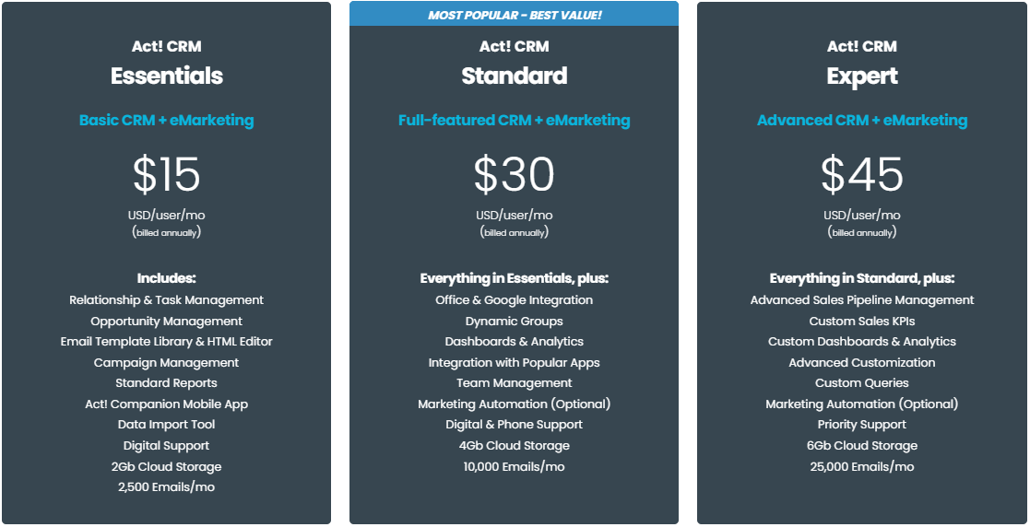
Big results. Small investment.
Choose from a range of affordable options that fit the needs of
your business, no matter where you are on your journey.

Slide 17
What’s new in Act!?

Slide 18
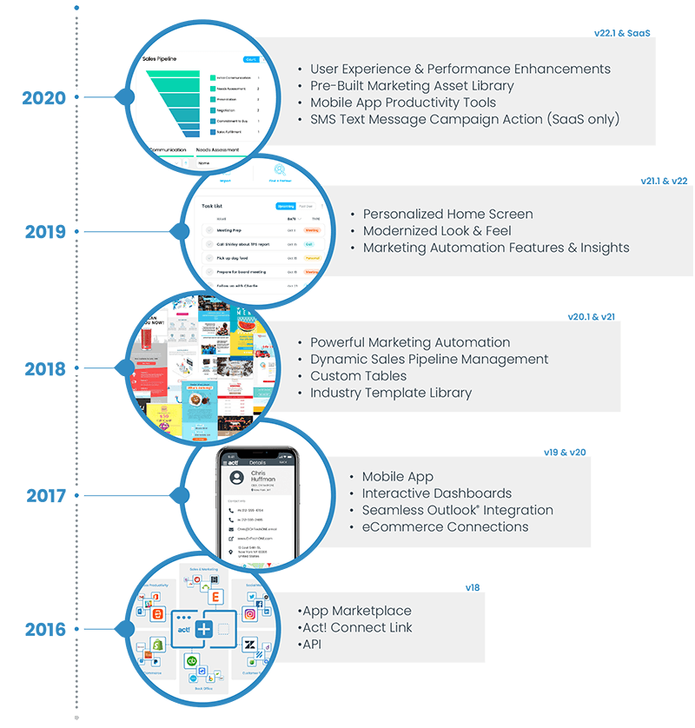
Recent Innovations
If you’re not on the latest version of Act!, you’re missing out on game-changing innovations and enhancements.
Check out what’s new since your version of Act!...
www.act.com/whatsnew

Slide 19
→ Call 866-873-2006 → Visit www.act.com → Contact your Act! Certified Consultant

Slide 20
Thank you!

